Slide 1
Unravelling Vasculitis Related Fatigue
Dr Neil Basu
Senior Lecturer of Rheumatology

Slide 2

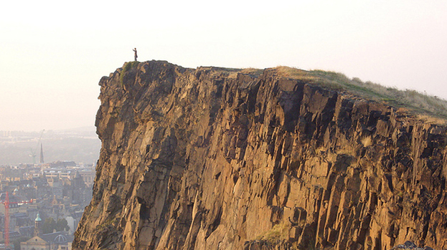
Re-shaped vasculitis landscape
Notes:
Years gone by the patient journey mirrored the downward trajectory of arthurs seat
With the change in therapy – now more chronic and fluctuating like landscape of isle of skye

Slide 3
Patient Priorities
Greatest burden of disease
  Fatigue (62%)
  Renal Failure
  Oxygen dependency
Patient-reported outcome assessment in vasculitis provides important data and a unique perspective P-XIV-152 (SA) Clin Exp Rheumatology Vol. 25 no.1, 2007(suppl.44)
Notes:
3

Slide 4

Definition of important fatigue
An overwhelming, debilitating, and sustained sense of exhaustion that decreases one's ability to carry out daily activities, including the ability to work effectively and to function at one's usual level in family or social roles

Slide 5
Quality of Life Impact in Vasculitis
Basu, ARD 2013

Slide 6
Work Disability Impact in Vasculitis
Work Disability
Disease Damage
Overweight
Depression

Slide 7
Work Disability Impact in Vasculitis
Work Disability
Disease Damage
Overweight
Fatigue
Depression

Slide 8

Why do doctors seem to ignore fatigue?

Slide 9
A potential model of vasculitis fatigue

Slide 10
Fatigue Management Programme
Interventions
  Exercise
  Talking therapies
Specialists
  Physiotherapy
  Psychology
  Nursing
  Occupational Therapy
Delivery
  Group
  One on one

Slide 11
Fatigue outcomes
Adapted from Basu 2013
Basu N, Rheumatology (Oxford) 2013

Slide 12
Exercise outcomes

Slide 13
Patient feedback
‘I can’t believe what I am able to do now’
‘My colleagues at work assume my steroids have been increased!’
‘I feel more optimistic about the future now’
‘I feel exhilarated’
‘A major turn around I never thought would be possible’

Slide 14
What is going wrong in the body to cause fatigue?
Central Mechanisms
Peripheral
Mechanisms

Slide 15
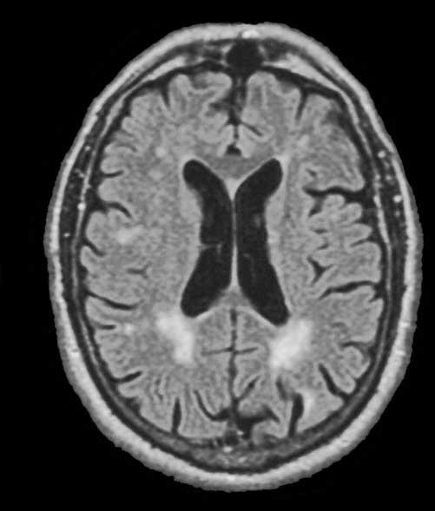
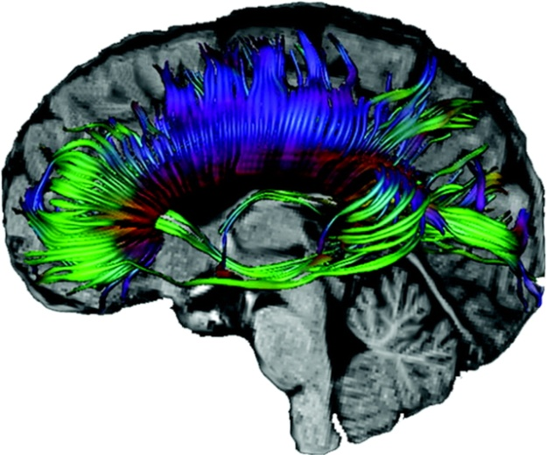
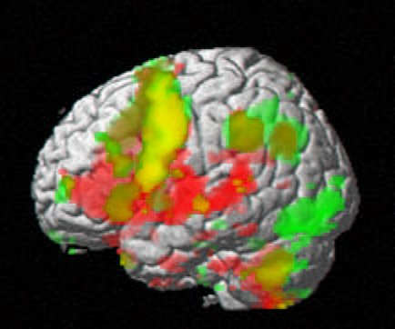
Vasculitis fatigue: role of the brain

Slide 16
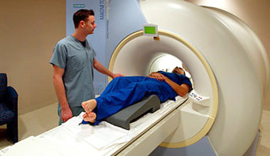

Slide 17
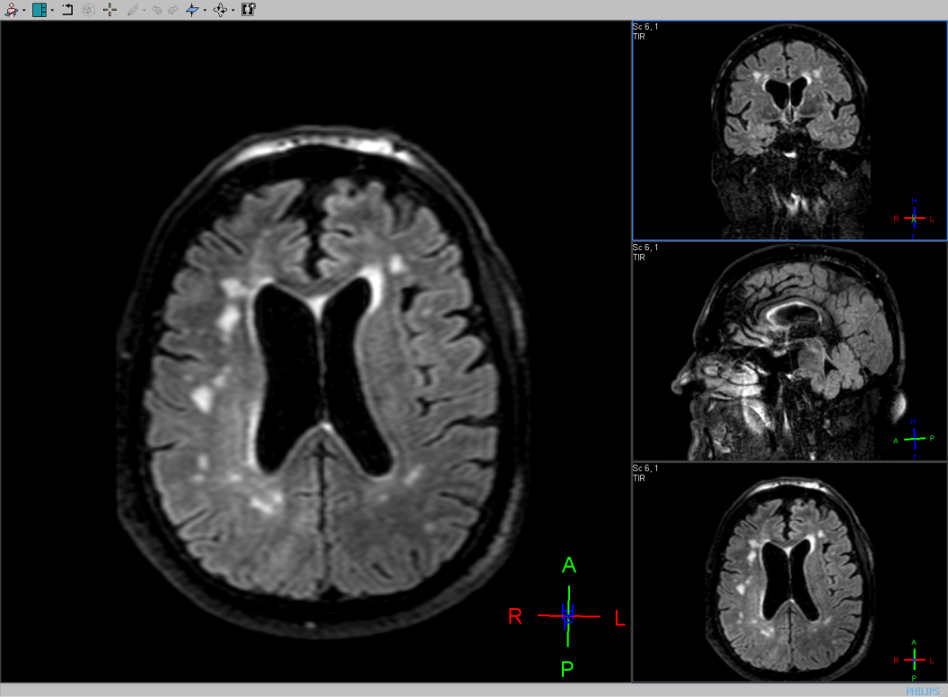
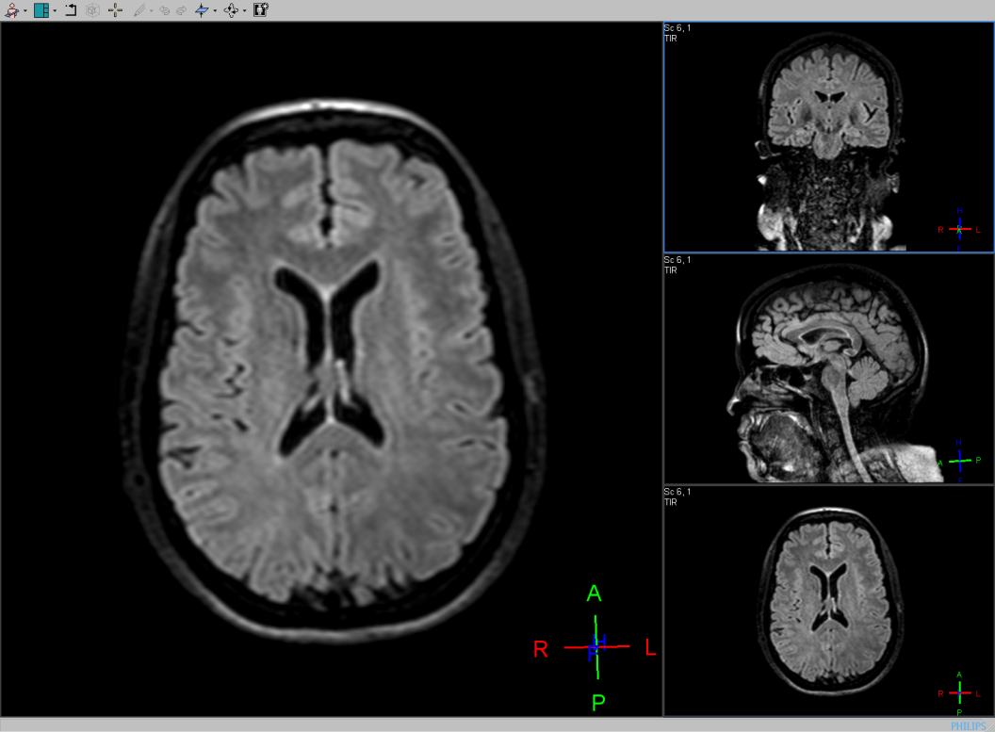
Are there any obvious differences?

Slide 18
Are there any subtle differences?
Basu et al, Rheumatology (2014) ¹⁷

Slide 19
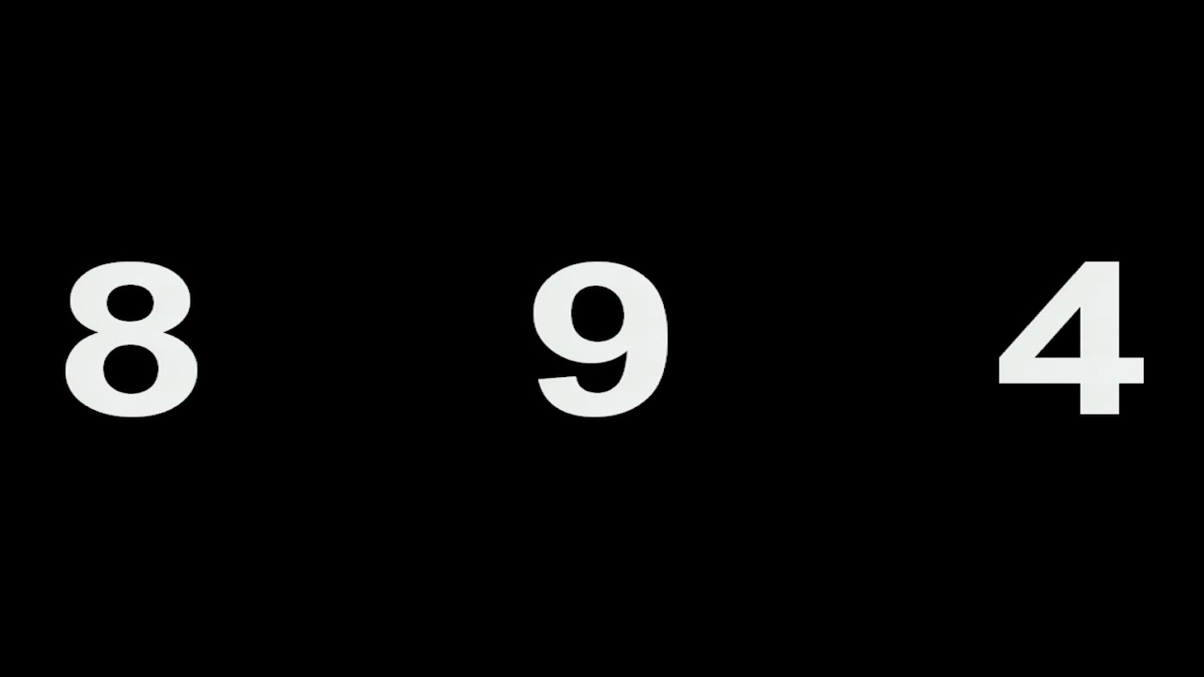
Fatiguing task

Slide 20
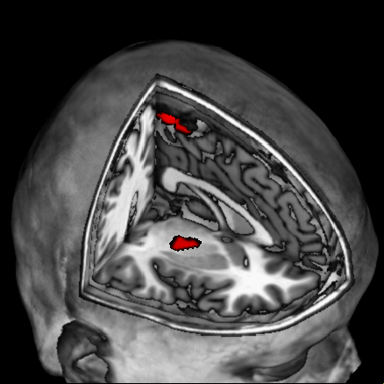
Are there blood flow differences in the brain in response to the fatiguing task?
Basu et al, Rheumatology (2014)

Slide 21
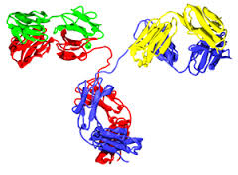

What is the potential?
Targets for new treatments
Objective measure of fatigue
Personalised medicine

Slide 22
Future
FATIGUE
Other pharmacological
Psychotrophic agents
Immune modifiers
Exercise
Behavioural interventions
Other non-pharmacological
Novel
Hormonal
Nutrients
Social support
Pacing
Education

Slide 23


